Slide 1
Kaggle Competition ASHRAE-Great Energy Predictor III
– Baby Valikala, Raj Ramchandani, Prakhar Prasad

Slide 2
Table of Contents
Introduction
Objective
Importing
Merging
Cleaning
Fitting
Predictions
Conclusion of results

Slide 3
Introduction
We predicted the cost of running a building so that we can be more energy efficient.
We have analyzed a data of a thousand buildings over a period of three years.
Our program is written in Python in Jupyter notebook.

Slide 4
Objective
Our aim was to predict the meter readings by applying Linear Regression.

Slide 5

Methodology - Importing
Imported packages– Pandas, NumPy, Sci-Kit Learn
Imported data – train data, test data, building meta data
After loading both packages and data we cleaned data

Slide 6
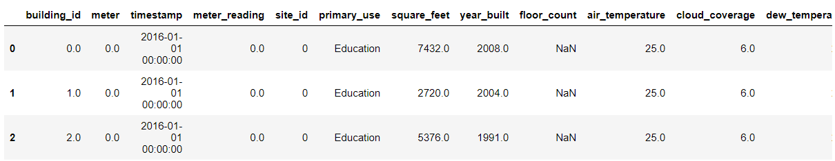
Methodology-Merging
Merged train and building meta data using outer join
This resultant was merged with the weather train

Slide 7
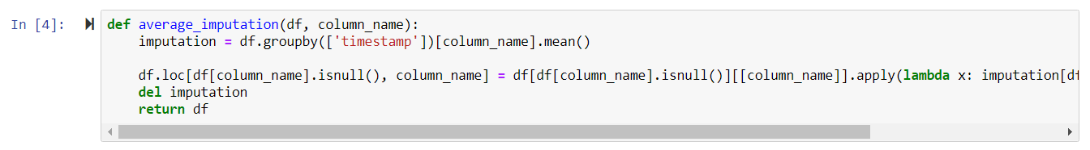
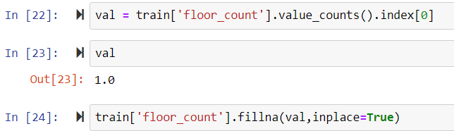
Methodology – Cleaning
Average Imputation – The missing values in continuous variables were filled by the average value of that column for that day.
The missing values in discrete variables were filled by the mode of the column

Slide 8
Methodology – Cleaning
Performing Label Encoding on columns which have categorical data.

Slide 9

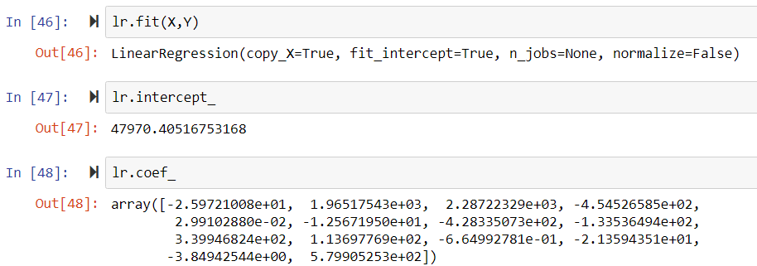
Methodology-Fitting the model
Y is set as the target variable/dependent variable
X is set as the independent variable
We have fitted the model of linear regression using SciKit Learn

Slide 10

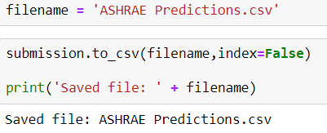
Methodology for Test
Merging the Test data with building metadata and weather train data as we did in the Training Part
Cleaning the data same way as we did in Training
Predicting the dependent variable for test data

Slide 11
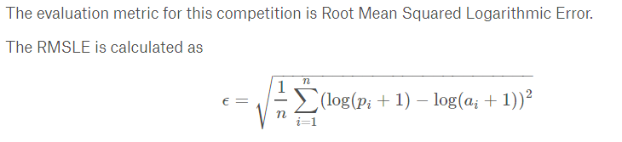
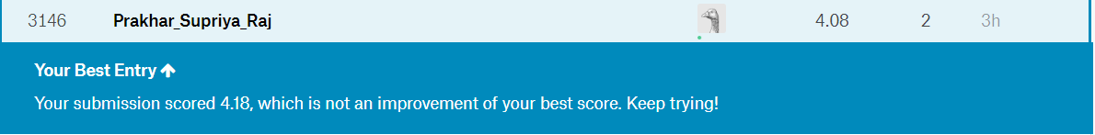
Conclusion
Received 4.08 on the RMSLE Error computed on the Kaggle.com

Slide 12
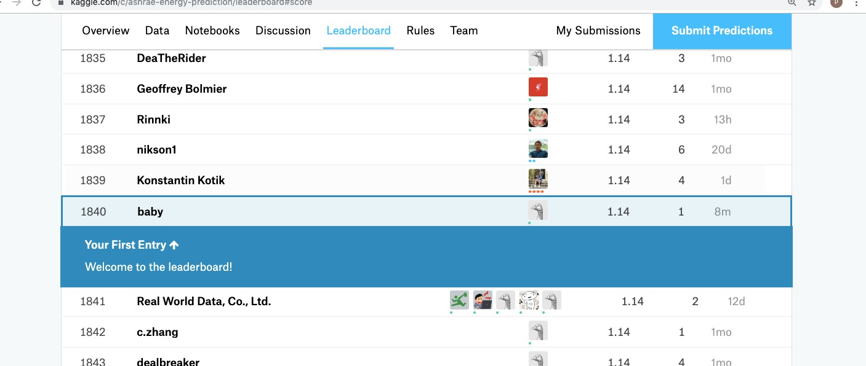
K-fold cross validation technique
By default we choose ‘Regression’ option here.
2-Cleaned the dataset and applied k-fold technique
3-We could see better Kaggle rak compared to linear regression.
4-We received a score of 1.14

Slide 13
Thank You

